Slide 1
Under Pressure
Sarah Castillo
20% Time

Slide 2
The Issue
Heart disease is the leading cause of death in the U.S.
High blood pressure = greater chance of heart disease
Checking blood pressure regularly can help manage and prevent heart disease

Slide 3
The Goal
Explore my passion of EE&CS
Create a wireless blood pressure monitor
Mobilize healthcare
Simpler
Affordable
Accessible
Portable

Slide 4
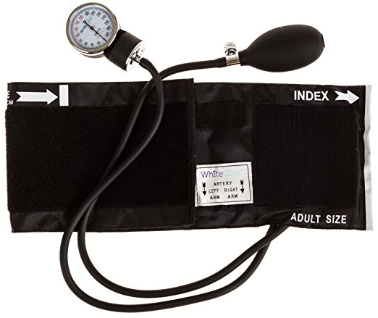
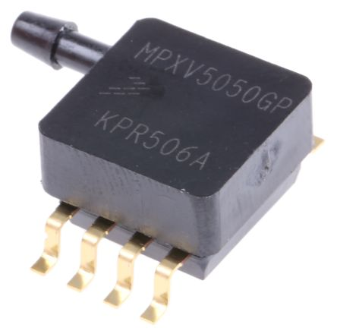
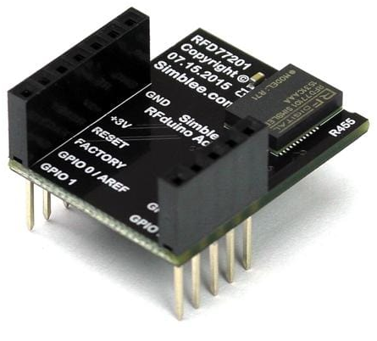
The Research
Previous papers on blood pressure monitors
Low-cost materials
No wireless
Pressure sensor
Microcontroller
Makes the blood pressure monitor wireless

Slide 5
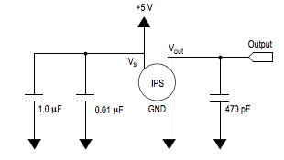
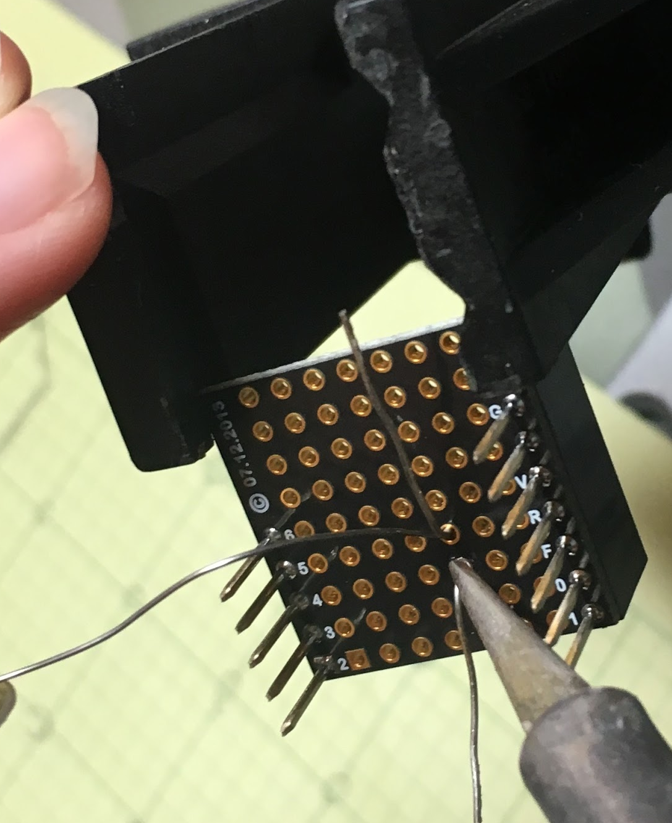
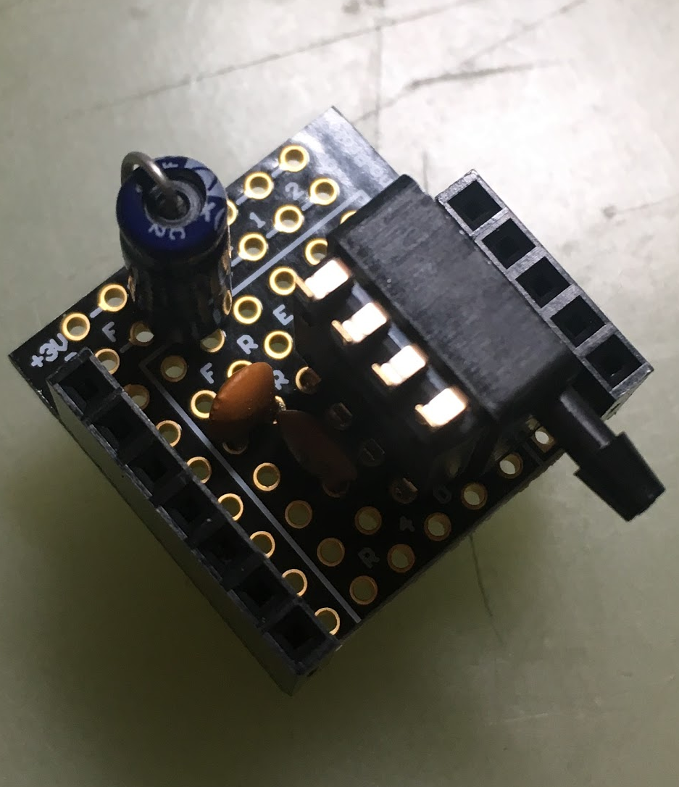
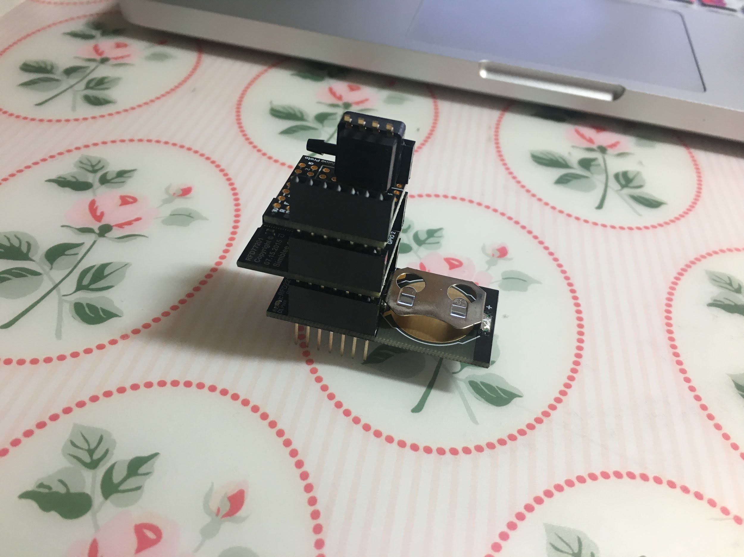
The Circuit
Capacitors reduce noise
Attached to microcontroller

Slide 6
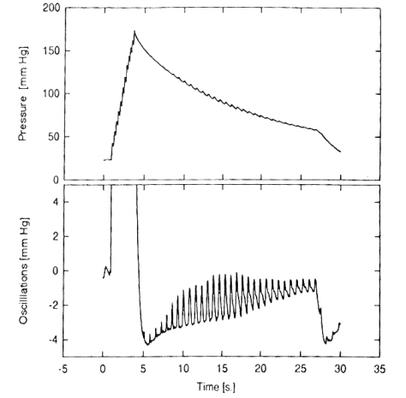
The Algorithm
Mean Arterial Pressure (MAP) = pressure @ maximum amplitude
Calculate systolic and diastolic pressure from the MAP

Slide 7
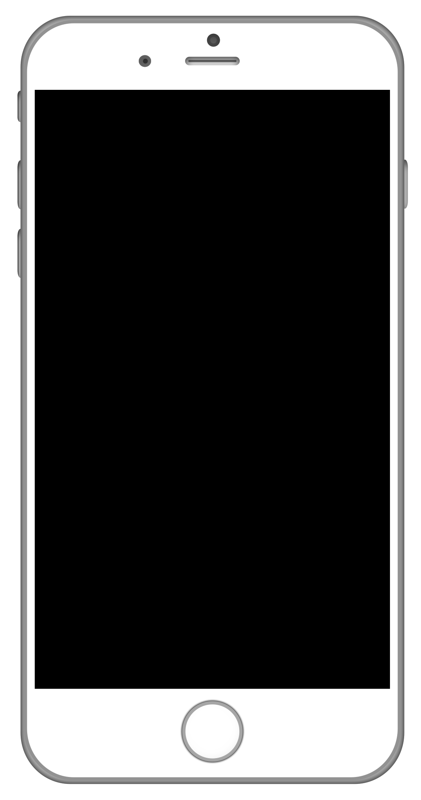
The Process
Measures pressure
Converts pressure to voltage
Sends voltage to phone
Finds systolic and diastolic pressure
Displays on phone screen
Notes:
Make bigger?

Slide 8
The Results

Slide 9
Link to Under Pressure video demo: https://drive.google.com/file/d/1nlDgC-wvqAUWKJZFMyV4YyCRsjA-lpI4/view?usp=sharing

Slide 10
The Lessons
Reconfirmed my passion and pursuit of engineering
Don’t need specialized education to accomplish ambitions
Success is found when you channel personal interest to help others
Notes:
Add real results

Slide 11
The Future...
Improve my application
User-friendly
Interactive
Informative
Share learning experiences
Notes:
Add real conclusion

Slide 12
Thank you!

